Slide 1
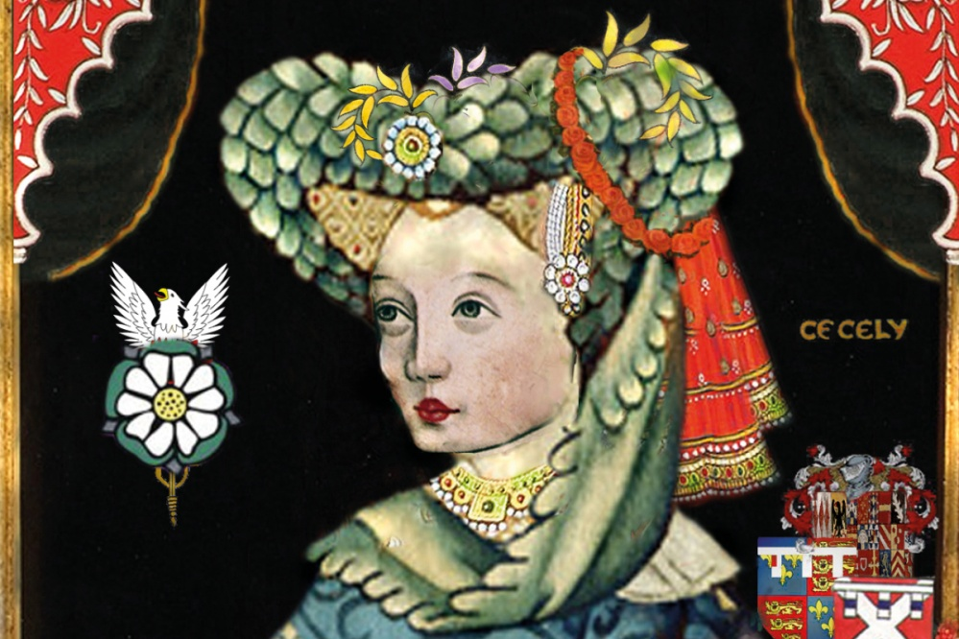
Cecily Neville, Duchess of York
Cecily Neville was an English noblewoman, the wife of Richard, Duke of York, and the mother of two kings of England—Edward IV and Richard III. Cecily was known as the Rose of Raby as she was born at Raby Castle Durham in 1415, and because of her pride and temper that went with it. Her husband, the Duke of York, was the leading contender for the throne of England from the House of York during the period of the Wars of the Roses until his death in 1460.
Their son Edward actually assumed the throne as Edward IV in 1461, after the deposition of King Henry VI of the House of Lancaster. Her second son was crowned King Richard III

Slide 2
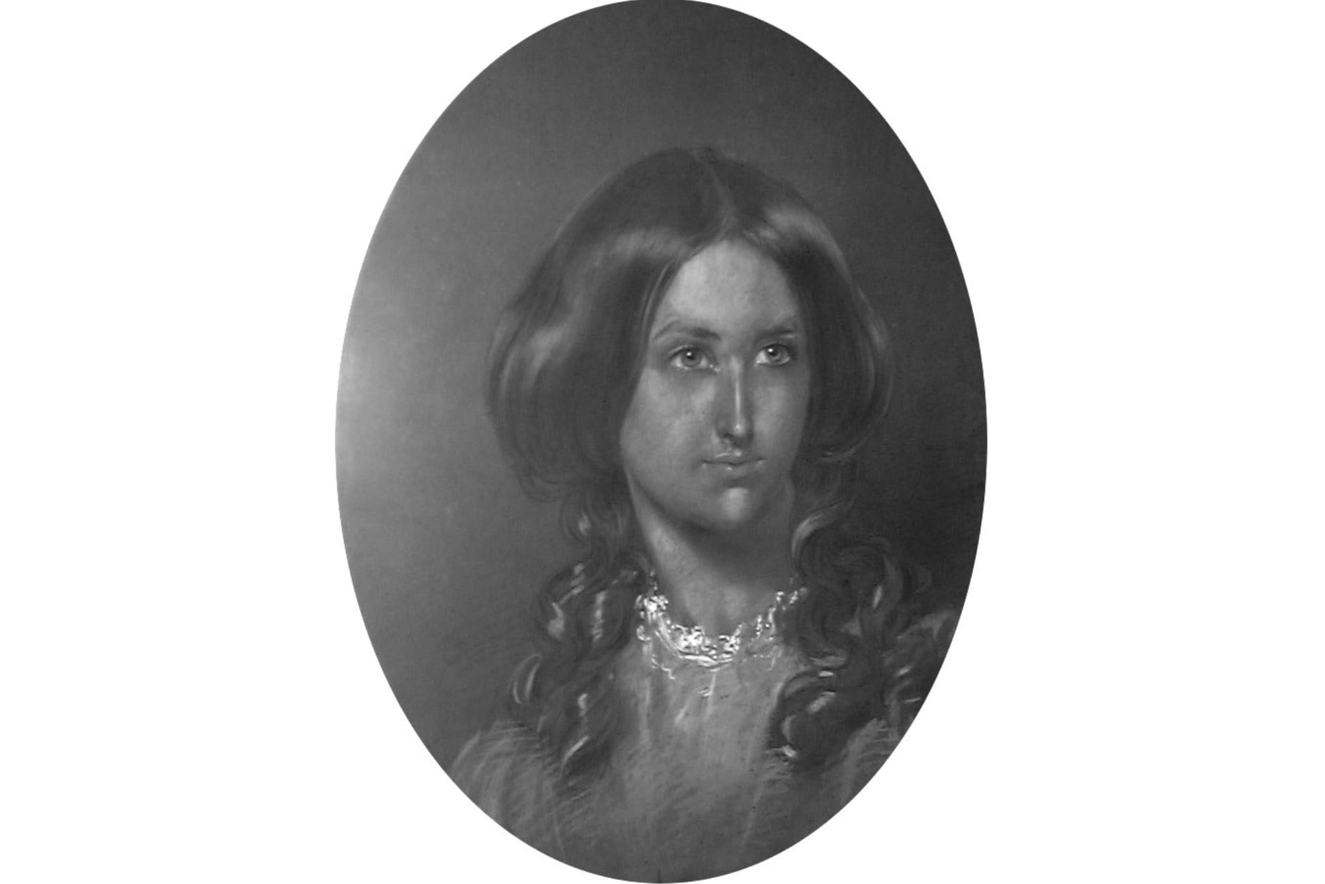
Janet Taylor
Janet Taylor, 1804, born Jane Ann Ionn, was an English astronomer, navigation expert, mathematician and meteorologist. She was born in Wolsingham, her father, Revd Peter Ionn was master of the Free Grammar School. This was one of the few north country schools that taught navigation. He enabled Janet to attend the basic grammar school and theoretical navigation tuition. She published works on astronomy and navigation, founded an academy for teaching these subjects. Her work was highly regarded and recommended by the East India Company, Trinity House and the Admiralty.
In recognition of her work, she was awarded medals by the Kings of Prussia and Kings of the Netherlands. Her rule of calculating latitudes was described as “ingenious”. She was one of the few women working as a scientific instrument maker in London in the 19th century. Her ‘Mariners Calculator”, patented in 1834, was dismissed by the Admiralty.

Slide 3
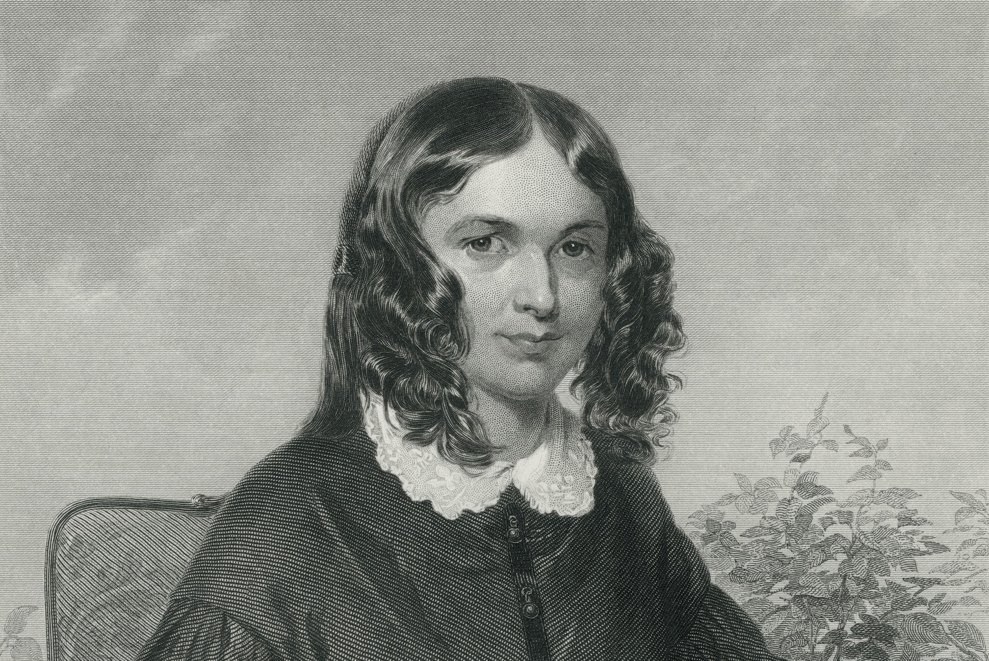
Elizabeth Barrett Browning
Born in Kelloe in 1806 the eldest of 12 children. She wrote poetry from age 11 years. Her mother’s collection of her poems is one of the largest extant collections of poetry written by someone in their youth by any English writer. In 1840s Elizabeth was introduced to literary society and wrote prolifically between 1841 – 1844, producing poetry, translation and prose. She campaigned for the abolition of slavery, her work helped to influence reform in the child labour legislation.
Her prolific output made her a rival to Tennyson as a candidate for poet laureate on the death of Wordsworth. Elizabeth’s work had a major influence on prominent writers of the day such as American poets Edgar Allan Poe and Emily Dickinson.

Slide 4
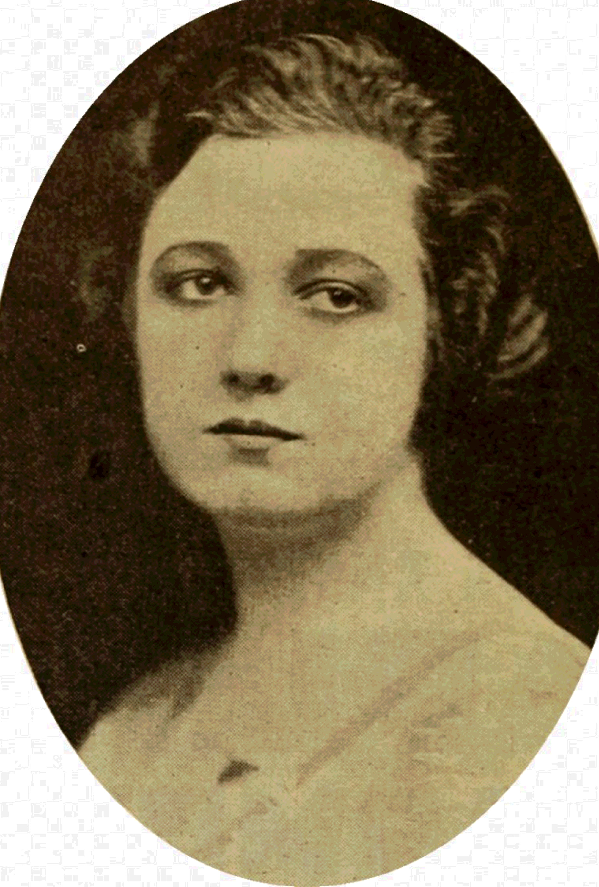
KATHERINE ROUTLEDGE
Katherine Maria Routledge (Nee Pease);
born 11 August 1866 – 13 December 1935 was an English archaeologist
and anthropologist who, in 1914, initiated and carried out much
of the first true survey of Easter Island. She was the second
child of Kate and Gurney Pease and was born into a
wealthy Quaker family in Darlington County Durham,
northern England. She graduated from
Somerville Hall (now Somerville College Oxford), with Honours
in Modern History in 1895, and for a while taught courses
through the Extension Division and at Darlington Training College.
After the Second Boer War she travelled to South Africa with
a committee to investigate the resettlement of single
working women from England to South Africa.
In 1906 she married William Scoresby Routledge. The couple
went to live among the Kikuyu people of what was then
British East Africa and in 1910 jointly published a book of their
research entitled With A Prehistoric People.

Slide 5
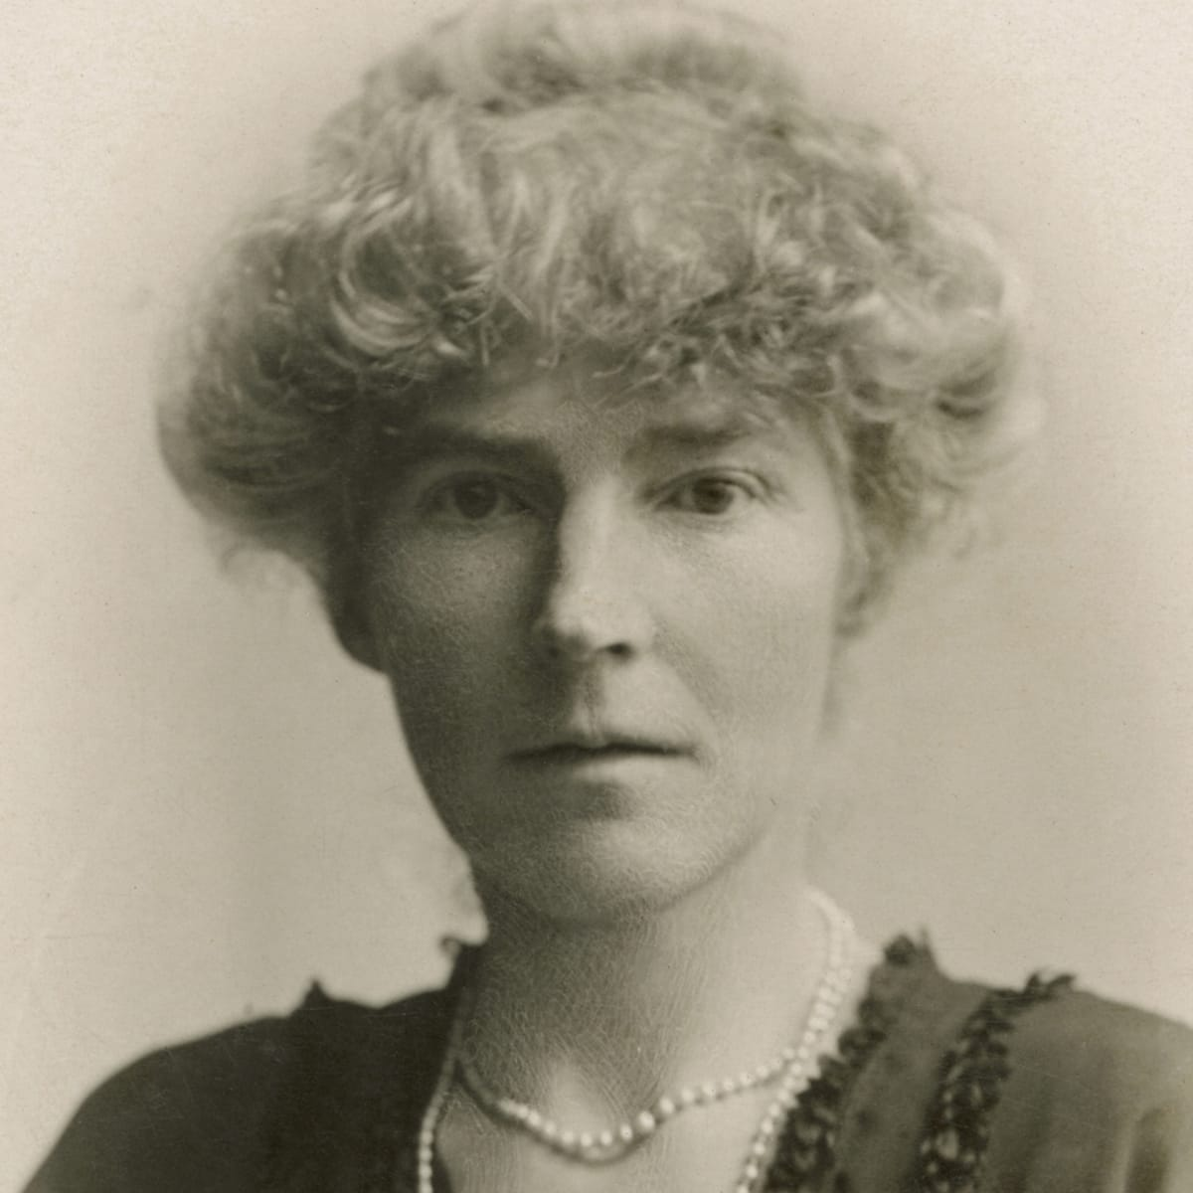
Gertrude Bell
Gertrude Bell born 1926 in Washington New Hall into a wealthy family. This enabled her to be educated and attend Oxford University aged 17 years, gaining a First Class Honours Degree in modern history, being one of the first women to graduate. She was an English writer, traveller, political officer , administrator and archaeologist who explored, mapped and became highly influential to British imperial policy making due to her contacts built up through extensive travels in Syria-Palestine, Mesopotamia, Asia Minor and Arabia.
She played a major role in establishing and helping to administer the modern state of Iraq. Gertrude was responsible for brokering peace between the Arabs and the Turks not Lawrence of Arabia.

Slide 6
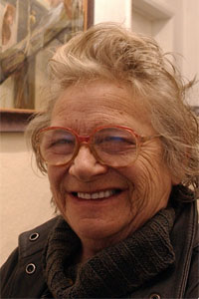
Sheila Mackie
Born 1928 in Chester Le Street and studied art at Kings College in Newcastle (now Newcastle University). She taught art at Consett Grammar School where she was head of department from 1950 and spent many months painting and working at Bertram Mills Circus. In later life she lived in Shotley Bridge where she painted in a caravan studio.
Several of her paintings were bought by the Derwentside District Council and are now owned by Durham County Council. Her painting Platform 4 Newcastle Station was bought in 1953 for the Government Art Collection. She illustrated books for Julian Glover’s Beowulf , Magnus Magnusson’s book on the Island of Lindisfarne and books by naturalist David Bellamy.

Slide 7
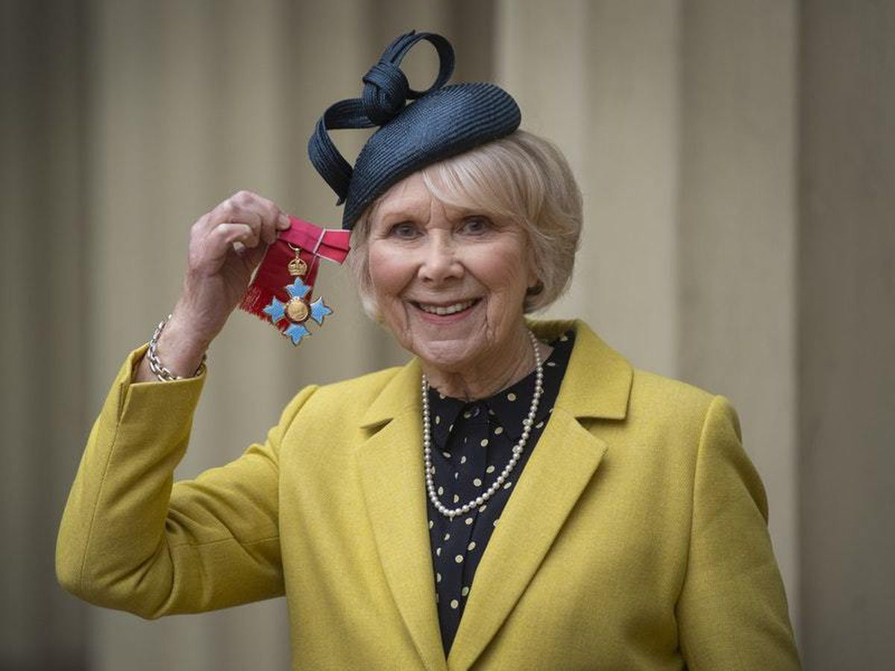
Wendy Craig CBE
Anne Gwendolyn Craig was born on 20 June 1934 in Sacriston County Durham, the daughter of a farmer, George Craig and his wife Anne (nee Lindsay). She attended Durham High School for Girls. Then went on to train as an actor at the Central School of Speech and Drama, at that time was based in the Royal Albert Hall London. Wendy starred in a variety of TV shows such as Butterflies along with many other notable roles.
She worked in films, The Servant and The Nanny with Bette Davis. In 2020 she was awarded the CBE (Commander of the British Empire) in the New Year Honours List for services to drama and charity.

Slide 8
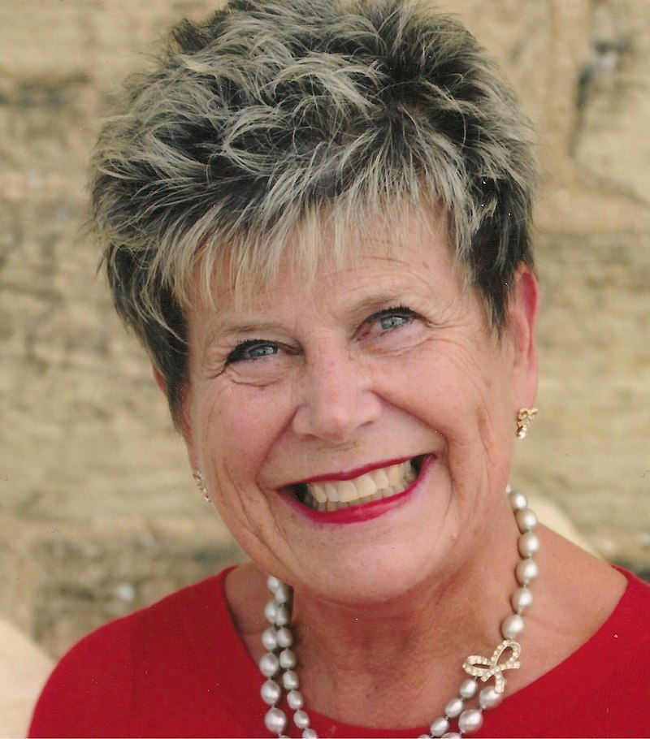
Susan Snowdon
Susan is the first woman to hold the post of Lord Lieutenant of County Durham, she was appointed in 2013. The daughter of a shop keeper, she became a primary school teacher, and a magistrate, working in Chiltern and Ferryhill. She was born 1951 in Croxdale Hall, Spennymoor. It was a maternity hospital at that time.
She co-ordinated the Durham Writing project and was tutor for Adult Literacy and Numeracy for many years. Sue served as a magistrate in County Durham and Darlington for 23 Years.
A great supporter of communities she was one of the founder members of the Bishop Auckland Town Centre Forum. She chaired the marketing and promotion group which developed and implemented an events led strategy designed to lift and raise the profile of the town and immediate surrounding areas.

Slide 9
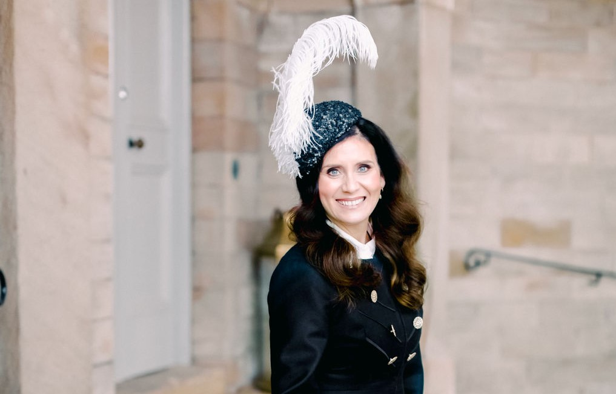
Shona Harper-Wilkes
First woman to be appointed the High Sheriff of Durham, 2022 – 2023. As part of the High Sheriff role, Mrs Harper-Wilkes has been appointed by the Queen to represent the monarch in County Durham, which also includes Darlington, Stockton, and Hartlepool. Born in 1974.
Her professional career started in marketing for a large blue-chip company, but, by 2001, she had successfully founded her own company CCP; one of the North’s leading training practitioners and consultancies. CCP’s training and recruitment support was successful in moving over 4000 vulnerable and disadvantaged adults and young people into sustainable employment each year, including ex-offenders and those working with Probation Services.
In her spare time, Shona performs and teaches several forms of dance. From winning her first competition at the tender age of 2 and a half, Shona has been a leading exponent of several forms of dance including ballet, tap, Highland, Scottish County and Durham Clog Dancing. By the age of 14, she had performed solo at Sadler’s Wells, the Royal Festival Hall and the RSC in Stratford on Avon. As part of Alistair Anderson’s and Kathryn Tickell ’s Great Northumbrian Road show, she has toured across the UK and internationally as well as being a founding tutor on the innovative Traditional Music Degree Programme based at the Sage Gateshead.

Slide 10
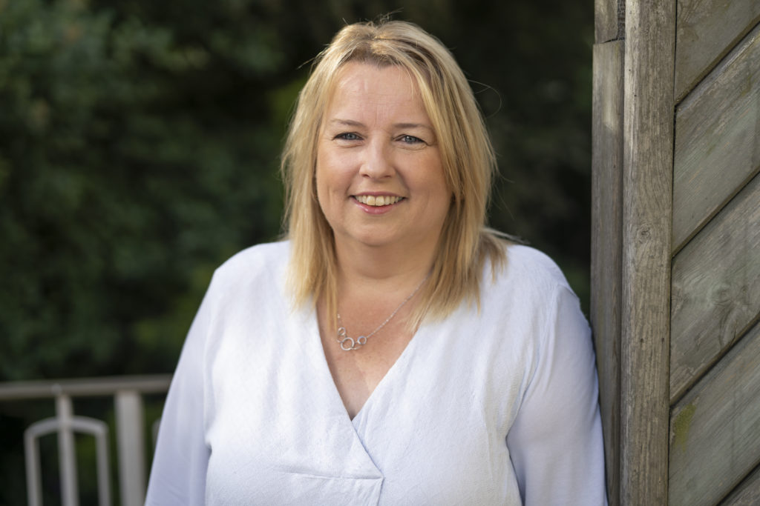
Amanda Hopgood
Appointed in 2021 Cllr Amanda Hopgood was voted into the post at the Annual Meeting, with her appointment marking a new political leadership for the council. She also makes history as the first woman to hold the position at what is the region's largest authority and one of the top 10 largest nationally.
As leader of the council's Liberal Democrat Group, she will lead a partnership of members from the Liberal Democrat, Conservative and independent groups under the name of the Joint Administration.
Cllr Hopgood was born 10th June 1970 in the old Dryburn hospital and has represented the Framwellgate and Newton Hall division of the council since 2008. She is also a member of Framwellgate Moor Parish Council.

Slide 11
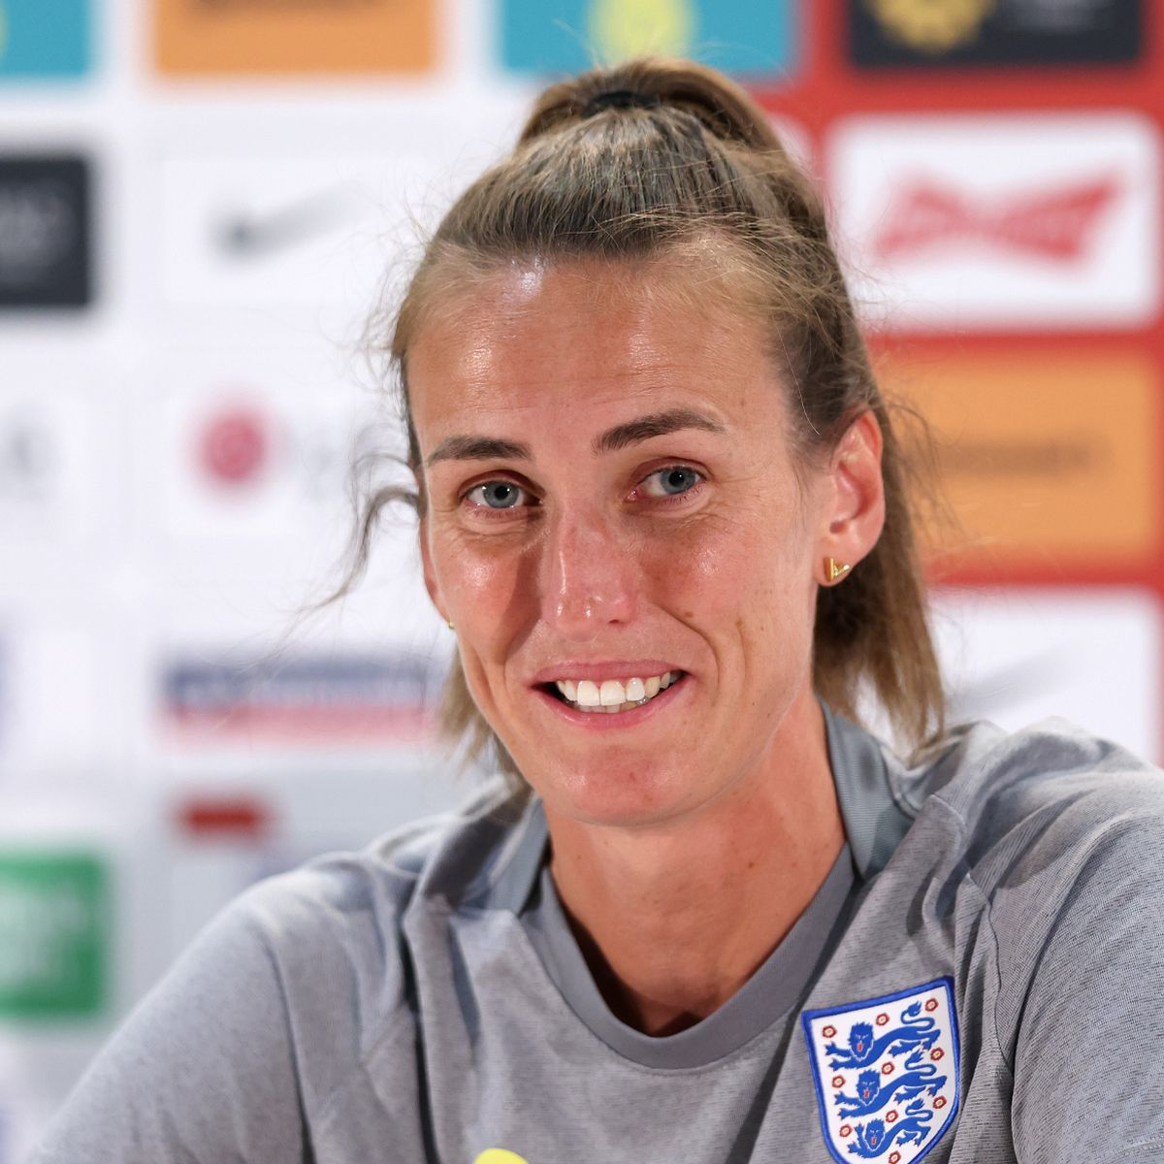
Jill Scott MBE
Jill Scott was born in Sunderland in 1987. One of England's most decorated players, Jill Scott is one of the select few Lionesses to have surpassed 150 caps and after featuring at no fewer than nine major tournaments she finally got a winners' medal as part of the team who won EURO 2022 on home soil.
The influential midfielder steps up to the plate whenever her country needs her most, and her England career has been punctuated with some key strikes – think the winner against Netherlands in the EURO 2009 semi-final, the equaliser against Belgium in EURO 2017 qualifying and the cute finish in the 3-0 win over Wales which sealed England’s place at France 2019.
Scott made her debut against Netherlands back in August 2006 and was on the plane to China for the World Cup a year later, where she scored in the 6-1 win over Argentina.

Slide 12
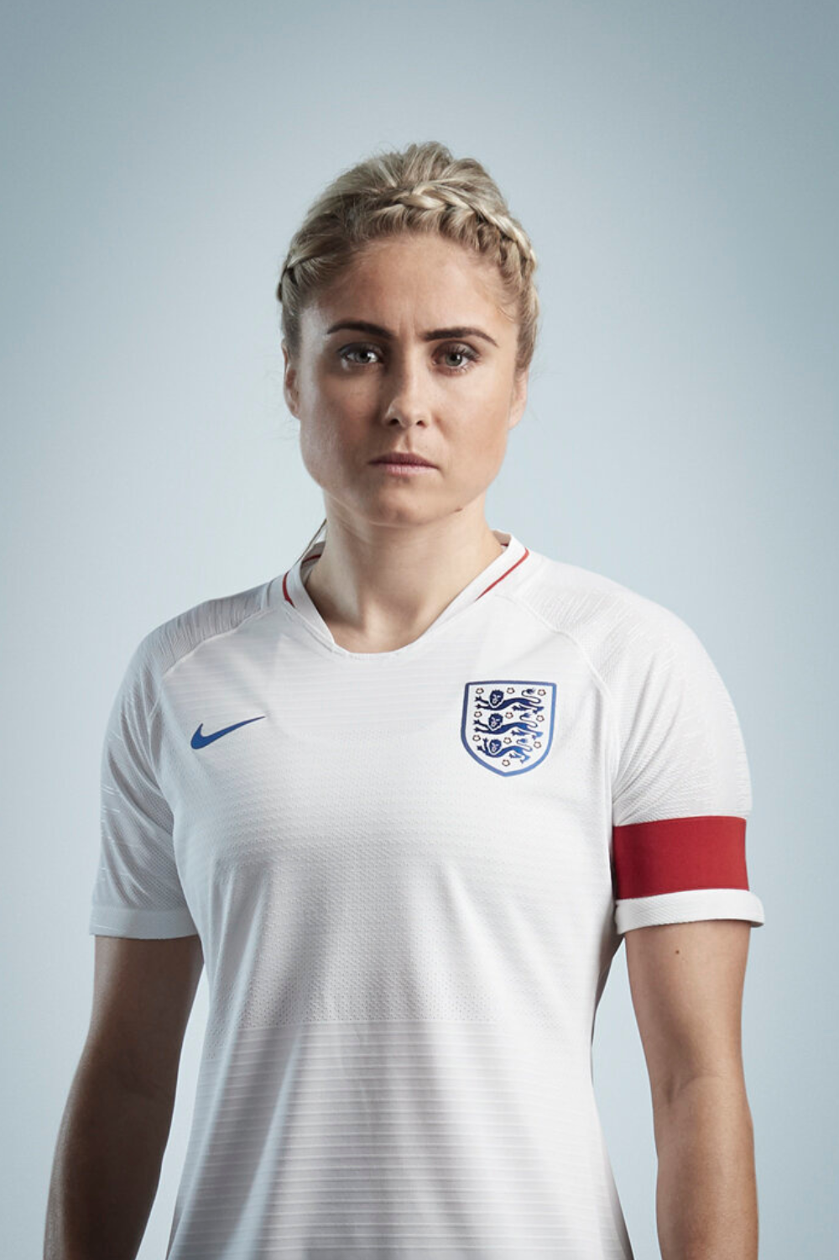
Steph Houghton MBE
Stephanie Jayne Houghton born in South Hetton in 1988. She became England Captain in 2014 and Defender gained 105 caps for England. Steph Houghton has represented her country at every level, totalling more than 100 appearances for England. She was awarded her 100th cap ahead of the meeting with Sweden at Rotherham last November.
She joined Manchester City on New Year’s Day 2014 in the hope of advancing an already illustrious career. Houghton turned professional at local club Sunderland Ladies before signing for Leeds United Ladies in 2007.
The transfer was a successful one for the Durham-born left-back who was named the 2008 FA Women’s Young Player of the Year. In 2010, she also picked up a FA Women’s Cup winners medal with Leeds.

Slide 13
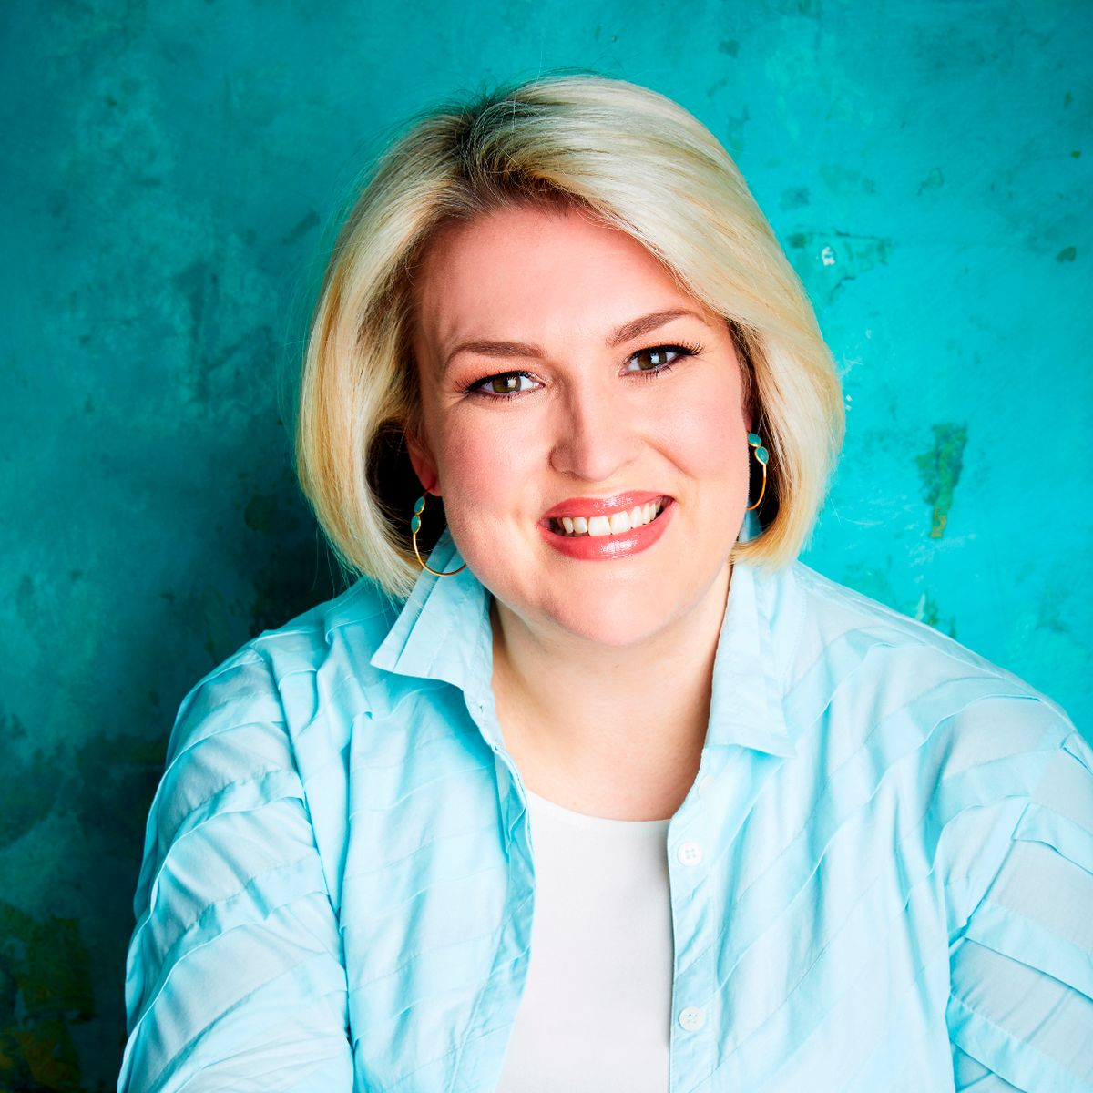
Sara Davies MBE
Sara Davies MBE born 23 April 1984 in Coundon County Durham. She is a British businesswoman, entrepreneur, and television personality. She is the founder and owner of Crafter's Companion, a company she started while a student at the University of York. In April 2019 it was announced that she would join the panel of the BBC television programme Dragon’s Den for its seventeenth series. In 2021 Davies was appointed the North East Ambassador for Smart Works Newcastle, a charity supporting unemployed women into work through clothing and coaching.
Having grown up surrounded by career-driven people and having watched my parents reap the rewards of owning their own companies, I knew that one day I wanted to do the same and thought that I could be the one to take over the family business.

Slide 14
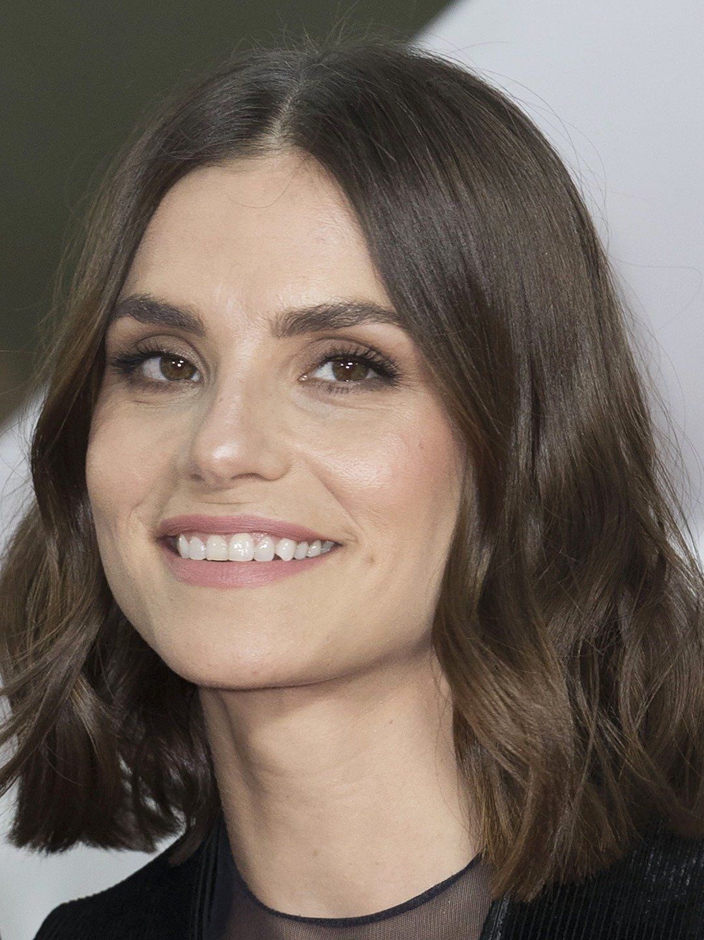
Charlotte Riley
Charlotte Frances Riley (born 29 December 1981) is an English actress. She is known for her roles as Sarah Hurst in Easy Virtue (2008) and as Catherine Earnshaw in ITVs adaptation of Wuthering Heights (2009).
She was born in Grindon, County Durham. Brought up in County Durham and attended Teesside High School from the age of 9 until 18. She attended St Cuthbert’s Society Durham, from 2000 to 2003, performing with the sketch comedy group, the Durham Revue and in plays and musicals graduating with a degree in English and Linguistics; she also attended the London Academy of Music and Dramatic Art from 2005 to 2007.

Slide 15
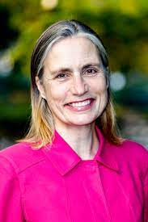
Fiona Hill
Fiona Hill (born October 1965) is a British American foreign affairs specialist and author. She is a former official at the U.S. National Security Council specializing in Russian and European affairs. She was a witness in the November 2019 House hearings regarding the impeachment inquiry during the first impeachment of Donald Trump. She earned a Ph.D. in history from Harvard University in 1998. She currently serves as a Senior Fellow at the Brookings Institute in Washington. She will take up office as Chancellor of Durham University in England in summer 2023.
Fiona was born in Bishop Auckland in County Durham in 1965, the daughter of a coal miner, Alfred Hill, and her mother June Murray was a midwife. Her father died in 2012; her mother still lives in Bishop Auckland. She and her sister attended Bishop Barrington a local comprehensive school In 2017, she recalled applying for Oxford University "I applied to Oxford in the '80s and was invited to an interview. It was like a scene from Billy Elliot: people were making fun of me for my accent and the way I was dressed. It was the most embarrassing, awful experience I had ever had in my life." She then read history and studied Russian at the University of St Andrews in Scotland.

